Slide 1
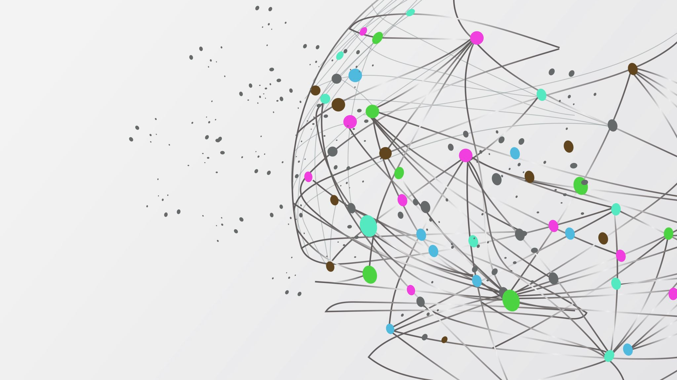
Error-Aware Model Training Framework for Compiler-Induced Perturbations
Sai Sathwik Annabathula(SXA230325)
Sai Charan Palvai(SXP240049)
Course: CS6375 – Machine Learning
Instructor: Dr. Wei Yang
Semester: Spring 2025

Slide 2
Introduction
Problem: Deep learning models suffer from numerical inconsistencies introduced by compiler optimizations like rounding or truncation.
Relevance: These inaccuracies, though subtle, can critically impact applications like autonomous driving or medical AI.
Objective: Train models that are robust to these perturbations by simulating errors during training time.

Slide 3
Motivation
Why this matters:
Safety-critical domains cannot tolerate silent failures from low-level errors.
Existing solutions focus on post-deployment fixes.
Our goal: Proactively build resilience into models during training.
Example: A healthcare model misclassifying an image due to a fused compiler instruction

Slide 4
Background – Key concepts
How do compilers affect DNNs?
Compiler backends alter arithmetic operations for speed/memory.
May reduce numerical precision or change computation order.
Impact:
Loss of model accuracy or stability.
Inconsistent results on different hardware

Slide 5
Related Work
Quantization-aware training: Focuses on fixed-point precision, not random error patterns.
Adversarial training: Adds perturbations to inputs, not internal tensors
Robust ML Research: Adversarial training focuses on input perturbations—not internal numerical inconsistencies.
Our uniqueness: Injects realistic internal errors into intermediate tensors during training.

Slide 6
Problem Formulation
Given: Model M, Compiler C, simulate error set E.
Train: A function T(M, C) such that the model remains accurate under E.
Challenges:
Different error types
Stable convergence despite noise
Efficiency during training

Slide 7
Proposed Framework
Key Components:
Error Injection Module: Simulates layer-wise arithmetic errors.
Error-Aware Loss: Penalizes sensitivity to simulated errors.
Workflow:
Inject noise in intermediate layers
Compute loss on clean and perturbed tensors
Backpropagate combined loss.
System Design:
Model ResNet-18 (modified)
Dataset Tiny ImageNet
Tools PyTorch, torchvision, AMP (mixed precision)
Code Features
Hook – Based error injection in Conv2D and Linear layers
Gradient scaling (AMP)
Cosine learning rate scheduler

Slide 8
Code Architecture
CompilerErrorSimulator: Adds noise to tensors with a probability.
ErrorAwareTrainingWrapper: Injects noise into model layers via hooks.
ErrorAwareLoss: Combines base loss with a robustness penalty.
train_model: Executes full training loop with error simulation.

Slide 9
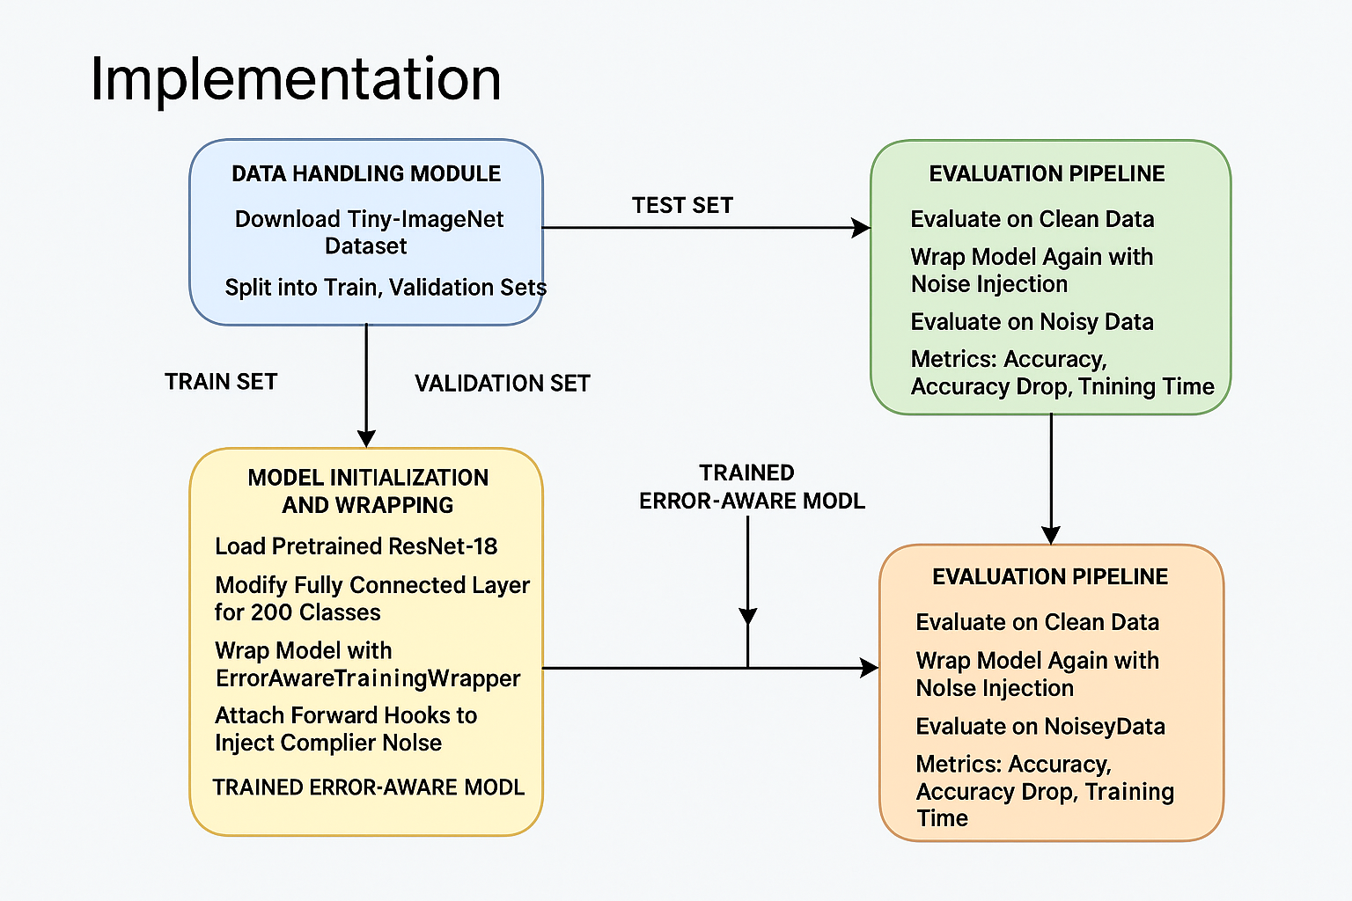
Implementation

Slide 10
Evaluation Setup
Comparison:
01
Error-Aware vs Standard Model
Metrics:
02
Accuracy on clean data
Accuracy with injected errors
Training time per epoch
Goal: Reduce performance drop under error conditions.
03

Slide 11
Results
Standard Accuracy:
Clean : 48.10%
With Errors: 47.96%
Error Aware Accuracy
Clean: 55.12%
With Errors: 55.01%
Drop: 0.14%
Drop: 0.11%

Slide 12
Standard model vs Error aware model
Feature | Standard Model | Error-Aware Model
Architecture | ResNet18 + Dropout + Linear(200) | Same
Error Injection (Hooks) | None | Via ErrorAwareTrainingWrapper Function
Custom Loss | Standard CrossEntropyLoss | ErrorAwareLoss Function: adds error penalty
Robustness Logic | None | Simulates noise during training
Training Code Location | Inline loop in main() | In train_model() function with full pipeline

Slide 13
Conclusion
We built a framework that injects compiler-style noise during training.
It improves model resilience with minimal performance overhead.
This approach enables safer ML deployment in critical domains.

Slide 14
Future Work
Profile and simulate real compiler behaviors (e.g., ONNX, TVM).
Extend to NLP models (e.g., BERT, GPT).
Dynamic simulation based on target deployment hardware (FPGA, Edge TPUs)

Slide 15
References
PyTorch Docs
Tiny ImageNet Dataset
ResNet-18
Prior Works on Adversarial and Robust Training
Deep Learning and Compiler Optimization Research

Slide 16

Thank you

